Slide 1
Single cell genomics workflow
Greg Gavelis, Julia Brown, Ramunas Stepanauskas
Bioinformatics of Microbial Single Cells
Wednesday April 3rd, 2024

Slide 2
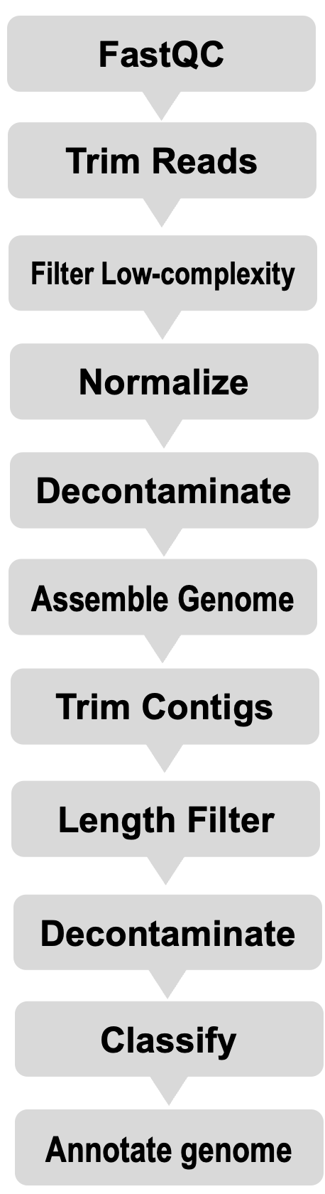
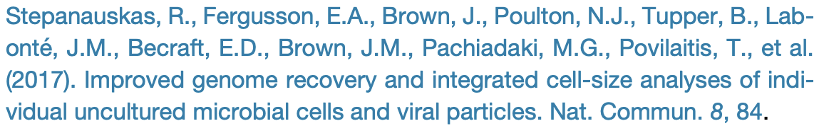
I. How we generate SAGs & annotations
SCGC pipeline published in:
Notes:
Each sample gets its own namesake folder. That folder contains the final genome assembly (e.g. AH-141-C18_contigs.fasta), and also three directories, where the products of varies pipeline steps are deposited. (Note that we don’t include all of the intermediates from read processing, since fastq files are very large.)

Slide 3
I. How we generate SAGs & annotations
SCGC pipeline published in:
Today: I’ll show you:
1. The bioinformatic tools we use.
Why we use those specific tools.
The exact commands & parameters we use.
2. How to interpret certain output files
Tetramer PCA
Particle summaries
Notes:
Each sample gets its own namesake folder. That folder contains the final genome assembly (e.g. AH-141-C18_contigs.fasta), and also three directories, where the products of varies pipeline steps are deposited. (Note that we don’t include all of the intermediates from read processing, since fastq files are very large.)

Slide 4
I. How we generate SAGs & annotations
SCGC pipeline published in:
Today: I’ll show you:
1. The bioinformatic tools we use.
Why we use those specific tools.
The exact commands & parameters we use.
2. How to interpret certain output files
Tetramer PCA
Particle summaries
Notes:
Each sample gets its own namesake folder. That folder contains the final genome assembly (e.g. AH-141-C18_contigs.fasta), and also three directories, where the products of varies pipeline steps are deposited. (Note that we don’t include all of the intermediates from read processing, since fastq files are very large.)

Slide 5
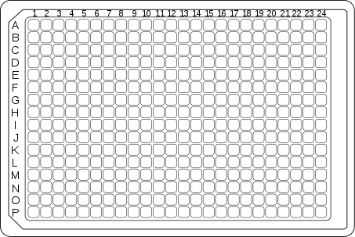
I. How we generate SAGs & annotations II. Where to find these files
Plate name: AG-910
We name SAGs like:
AG-910-A01
AG-910-A02
AG-910-A03
We’ve generated >200,000 SAGs, across 100s of plates.
So it’s important to keep the data organized.
Plate Well
Notes:
Each sample gets its own namesake folder. That folder contains the final genome assembly (e.g. AH-141-C18_contigs.fasta), and also three directories, where the products of varies pipeline steps are deposited. (Note that we don’t include all of the intermediates from read processing, since fastq files are very large.)

Slide 6

I. How we generate SAGs & annotations II. Where to find these files
Plate name: AG-910
We’ve generated >200,000 SAGs, across 100s of plates.
So it’s important to keep the data organized!
Each SAG gets its own folder
AG-910-A01
Notes:
Each sample gets its own namesake folder. That folder contains the final genome assembly (e.g. AH-141-C18_contigs.fasta), and also three directories, where the products of varies pipeline steps are deposited. (Note that we don’t include all of the intermediates from read processing, since fastq files are very large.)

Slide 7
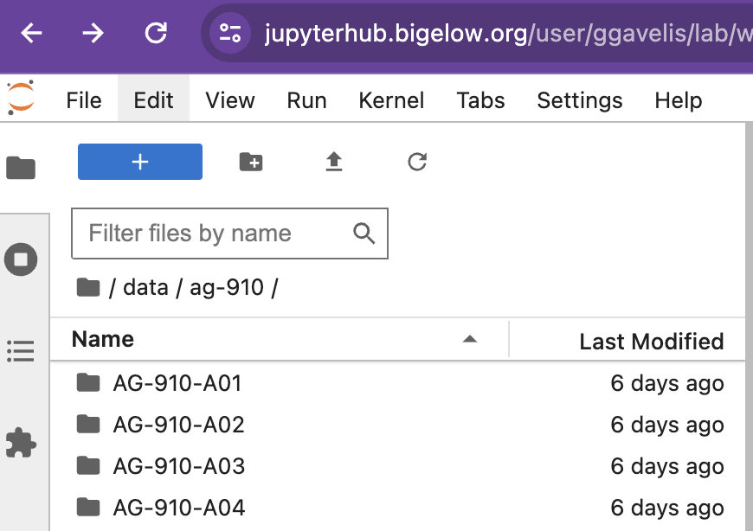
II. Where to find these files /mnt/storage/data/ag-910
AG-910-A01
Notes:
Each sample gets its own namesake folder. That folder contains the final genome assembly (e.g. AH-141-C18_contigs.fasta), and also three directories, where the products of varies pipeline steps are deposited. (Note that we don’t include all of the intermediates from read processing, since fastq files are very large.)

Slide 8



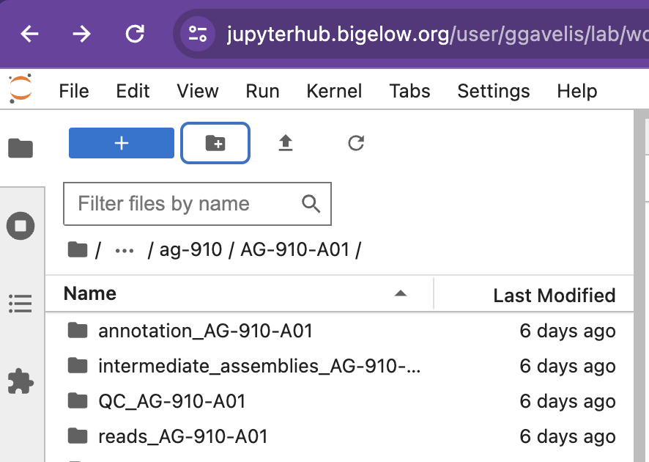
II. Where to find these files
AG-910-A01
/mnt/storage/data/ag-910/AG-910-A01
AH-141-D10
AH-141-I04
Have generated >200,000 of them!
reads_{ID}
annotation_ {ID}
QC_{ID}
Notes:
Each sample gets its own namesake folder. That folder contains the final genome assembly (e.g. AH-141-C18_contigs.fasta), and also three directories, where the products of varies pipeline steps are deposited. (Note that we don’t include all of the intermediates from read processing, since fastq files are very large.)

Slide 9
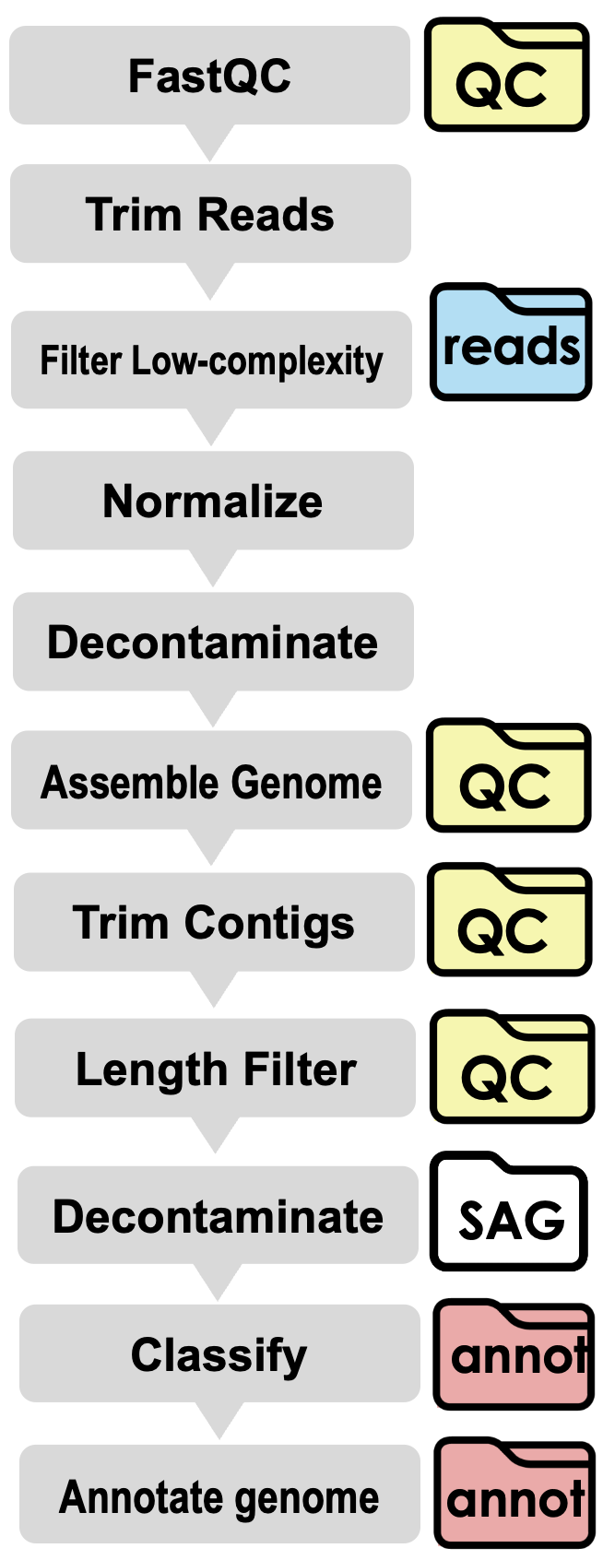
II. Where to find these files
AG-910-A01
/mnt/storage/data/ag-910/AG-910-A01
AH-141-D10
AH-141-I04
Have generated >200,000 of them!
reads_{ID}
annotation_ {ID}
QC_{ID}
Notes:
Each sample gets its own namesake folder. That folder contains the final genome assembly (e.g. AH-141-C18_contigs.fasta), and also three directories, where the products of varies pipeline steps are deposited. (Note that we don’t include all of the intermediates from read processing, since fastq files are very large.)

Slide 10
Now, let’s dive into the pipeline!

Slide 11
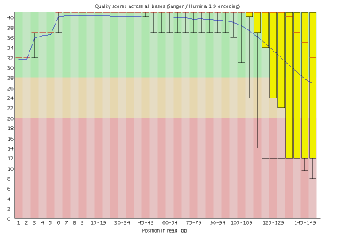
1. Report Read Quality
PIPELINE
FastQC
QC
Trim Reads
fastqc –q {forward.fastq} {reverse.fastq}
Filter Low-complexity
Normalize
reads
Decontaminate
Assemble Genome
QC
Notes:
Before processing, we review the quality of the raw reads, using the program fastqc to output html report files, like above. These are included in the QC subfolder. Note that the quality of the basecalls tends to decline as we reach the end of the 150 bp read.

Slide 12
2. Trim Reads
PIPELINE
FastQC
QC
Trim Reads
Remove low quality 5’ and 3’ bases.
trimmomatic PE -phred33 \
{Forward.fastq} \
{Reverse.fastq} \
LEADING:0 TRAILING:5 SLIDINGWINDOW:4:15 MINLEN:36
Filter Low-complexity
Normalize
reads
Decontaminate
Assemble Genome
QC
Notes:
For our next step, we use the program trimmomatic to remove these low quality reads. Reads under 36 bp are discarded.

Slide 13
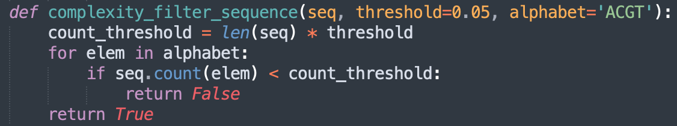
3. Remove low-complexity read pairs
PIPELINE
FastQC
QC
Trim Reads
Low-complexity reads cause misassemblies.
So we filter them with a custom script.
How? Read pair is ”low complexity” if it contains <5% of A,C,G or T.
Is this pair sufficiently complex?:
>Forward_Read_1
AAAAAAATTTTTTTTAAAAAATATATATATAGATATAC
+
>Reverse_Read_1
ATATATACCCCCCCCCCTATATACCCCCCCCCCTATATA
Script logic (in python):
Filter Low-complexity
reads
Normalize
Decontaminate
Assemble Genome
QC
Notes:
Step 3, we remove low-complexity reads include (e.g. homopolymer runs ”AAAAAA” and repeats “ATATATA’). If not removed, low complexity sequences can cause misassemblies

Slide 14
4. Normalize reads
PIPELINE
PIPELINE
FastQC
QC
Trim Reads
For computational efficiency, downsample read pairs with over-represented kmers.
(our kmers are 21bp subsequences.)
Command:
kmernorm -k 21 -t 30 -c 3 \
{readpairs.fastq} > {ID}_normalized_pe.fastq
Filter Low-complexity
reads
Normalize
Notes:
Kmernorm is much faster than the the read normalization program that comes built into the assembly software. Normalization allows assembly to run ~10X faster and with no significant decline in assembly quality.

Slide 15
5. Remove contaminant reads
PIPELINE
PIPELINE
FastQC
QC
Trim Reads
Lab reagents can have contaminants.
Remove them with a custom python script
1. Use BWA to align reads to known reagent contaminants (ref_contam.fa)
Human
Cutibacterium
Ralstonia, etc.
2. Remove reads that align to ref_contam.fa
Command:
bwa aln -n 0.05 ref_contam.fa {ID}_reads.fastq
= reference threshold
Filter Low-complexity
reads
Normalize
Decontaminate
Notes:
For the first of three decontamination steps, we remove reads that align to nucleotides in a custom database of genomic contaminants. We obtained these contaminants by sequencing ‘empty’ (i.e. negative control) plates in the clean lab.

Slide 16
Midway review: How did we prepare our reads? Which step removes the most reads?
PIPELINE
PIPELINE
FastQC
QC
Trim Reads
Filter Low-complexity
reads
Normalize
Decontaminate

Slide 17
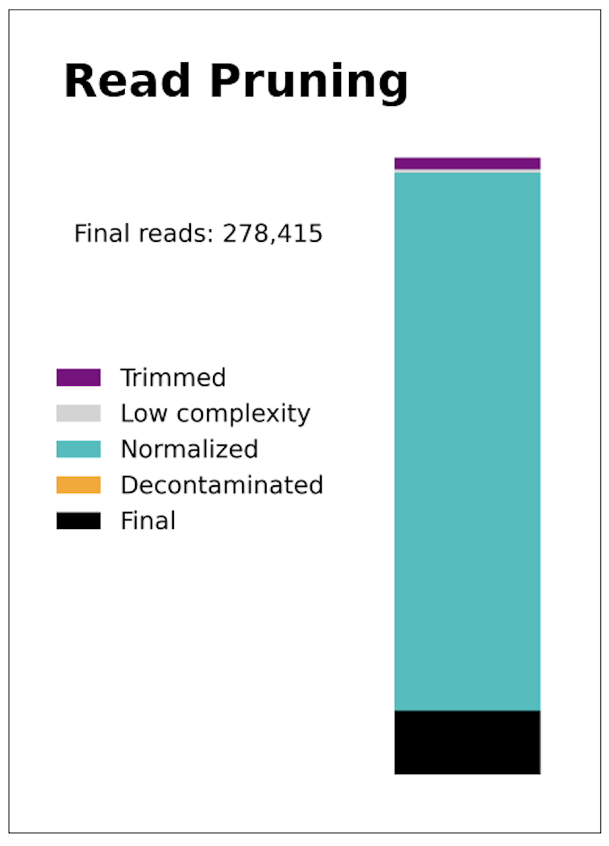
Midway review: How did we prepare our reads? Which step removes the most reads?
PIPELINE
PIPELINE
FastQC
QC
Trim Reads
Raw reads: 1,670,058
Filter Low-complexity
reads
Normalize
Decontaminate
Notes:
Why does kmernorm remove so many readpairs? Because MDA introduces extreme amplification bias (orders-of-magnitude difference in coverage between different regions).

Slide 18
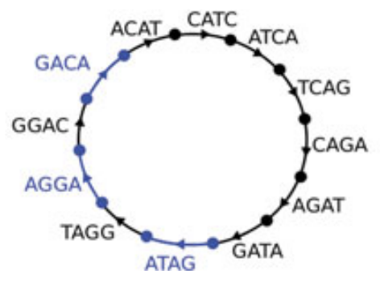
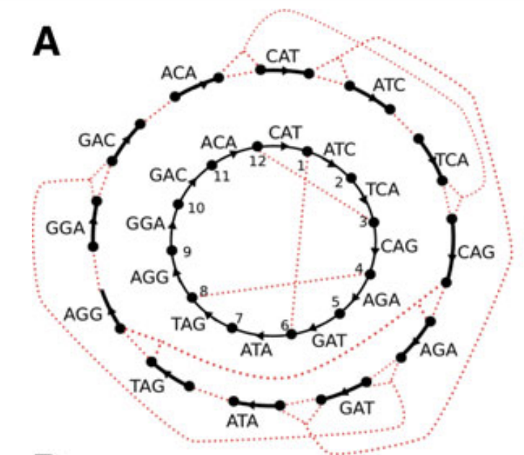

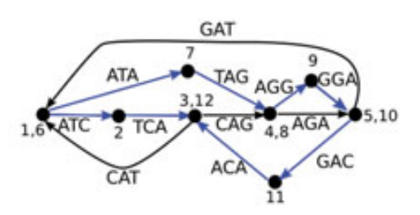
6. Time to assemble the genome!
SPAdes uses de-bruijn graphs (across various kmer sizes) to assemble contigs.
Takes read-pairs into account.
Unlike other assemblers, it doesn’t rely much on read-coverage. (Expects uneven cov’ due to amplification bias)
Notes:
SPAdes is unparalleled for the “de-novo” (i.e. reference-free) assembly of DNA obtained from single cells. Critically, it assumes that coverage of input reads will be highly uneven (due to amplification bias introduced during Multiple Displacement Amplificiation).

Slide 19
7. SPAdes
FastQC
QC
Trim Reads
spades.py -o {ID}_all_contigs.fasta \
--careful \
--sc \
--phred-offset 33 \
{reads.fastq}
-k 21 -t 30 -c 3 \
{readpairs.fastq} > {ID}_normalized_pe.fastq
Filter Low-complexity
reads
Normalize
Decontaminate
Assemble Genome
QC
Notes:
We make sure to run spades in single-cell mode, so that it does not take read coverage into account. This output assembly is considered raw and likely has some areas that need to be processed. The next several slides deal with matters of QC, that have been carefully optimized.

Slide 20
8. BLAST raw contigs against NCBI nr/
FastQC
QC
Trim Reads
Filter Low-complexity
reads
-> To file named “BLAST_raw_contigs_{ID}.tsv”
A good place to look if you’re wondering about possible contaminants in your assembly.
Normalize
Decontaminate
Assemble Genome
QC
BLASTn
QC

Slide 21
FastQC
QC
9. Trim contigs
Trim Reads
Filter Low-complexity
reads
Most misassemblies occur at ends of contigs (200 bp)
Normalize
Decontaminate
Length filtering
Assemble Genome
QC
Trim Contigs
QC
Discard assemblies under 2000 bp.
Length Filter
QC

Slide 22

10. Filter contaminant contigs
FastQC
QC
Trim Reads
Filter Low-complexity
reads
BLASTn contigs against ref_contam.fa (see step 5).
Then, discard contigs whose alignments to contam have:
>=95 perc_id
AND
>=100 bp length
The final cleaned assembly is in:
final_contigs_{ID}.fasta
Normalize
Decontaminate
Assemble Genome
QC
Trim Contigs
QC
Length Filter
QC
{Sample_ID}
Decontaminate
SAG
Classify 16s
QC
Annotate genome
annot

Slide 23
11. How complete is the genome assembly?
QC
Estimate with CheckM1
We use CheckM1 (marker gene-based) vs. CheckM2 (neural network-based) because CheckM1 is more transparent.
Important CheckM1 fields:
“Completeness” (%)
“Translation table” (only evaluates 4 and 11)
“Multicopy marker genes” (#)
Can be useful for inferring contamination.

Slide 24

12. Who is this genome from? SSU / 16s-based classification
annot
We use an in-house script based on CREST (Lanzén et al. 2012)
How it works
1. Finds 16s region(s) in SAG by BLASTing contigs against Silva database
2. Refines 16s regions by aligning them to Silva with Samtools
3. Assigns Linnean classification based on closest Silva reference.
-> {ID}_SSU.tsv
Example:
k__Bacteria;p__Proteobacteria;c__Gammaproteobacteria;o__E01-9C- 26_marine_group;f__?;g__?;s__?
Strengths: Fast and can assign multiple 16s sequences per SAG.
Limitations: Incomplete genomes may not have 16s.
SSU_rRNA
_recovery
Notes:
This is only one classification approach. In coming lectures we’ll talk about how multigene approaches are also used.

Slide 25
12. Who is this genome from? SSU / 16s-based classification
annot
We use an in-house script based on CREST (Lanzén et al. 2012)
How it works
1. Finds 16s region(s) in SAG by BLASTing contigs against Silva database
2. Refines 16s regions by aligning them to Silva with Samtools
3. Assigns Linnean classification based on closest Silva reference.
-> {ID}_SSU.tsv
Example:
k__Bacteria;p__Proteobacteria;c__Gammaproteobacteria;o__E01-9C- 26_marine_group;f__?;g__?;s__?
Strengths: Fast and can assign multiple 16s sequences per SAG.
Limitations: Incomplete genomes may not have 16s.
SSU_rRNA
_recovery
Notes:
This is only one classification approach. In coming lectures we’ll talk about how multigene approaches are also used.

Slide 26
12. Who is this genome from? SSU / 16s-based classification
annot
We use an in-house script based on CREST (Lanzén et al. 2012)
How it works
1. Finds 16s region(s) in SAG by BLASTing contigs against Silva database
2. Refines 16s regions by aligning them to Silva with Samtools
3. Assigns Linnean classification based on closest Silva reference.
-> {ID}_SSU.tsv
Example:
k__Bacteria;p__Proteobacteria;c__Gammaproteobacteria;o__E01-9C- 26_marine_group;f__?;g__?;s__?
Strengths: Fast and can assign multiple 16s sequences per SAG.
Limitations: Incomplete genomes may not have 16s.
SSU_rRNA
_recovery
Notes:
This is only one classification approach. In coming lectures we’ll talk about how multigene approaches are also used.

Slide 27
12. Who is this genome from? SSU / 16s-based classification
annot
We use an in-house script based on CREST (Lanzén et al. 2012)
How it works
1. Finds 16s region(s) in SAG by BLASTing contigs against Silva database
2. Refines 16s regions by aligning them to Silva with Samtools
3. Assigns Linnean classification based on closest Silva reference.
-> {ID}_SSU.tsv
Example:
k__Bacteria;p__Proteobacteria;c__Gammaproteobacteria;o__E01-9C- 26_marine_group;f__?;g__?;s__?
Strengths: Fast and can assign multiple 16s sequences per SAG.
Limitations: Incomplete genomes may not have 16s.
SSU_rRNA
_recovery
Notes:
This is only one classification approach. In coming lectures we’ll talk about how multigene approaches are also used.

Slide 28
13. Who is this genome from? GTDB-Tk (v2) for multigene classification
annot
How it works:
Places SAG in established prokaryote phylogeny based on:
120 bacterial marker genes:
OR
53 archaeal marker genes:
Strengths:
Phylogenomic-like approach.
Uses GTDB taxonomy (a rank-normalized hierarchy)
Limitations:
Confounded if SAG is chimeric (contains marker genes from multiple taxa)
Not for eukaryotes (a.k.a. “Lokiarchaeota”)
gtdbtk_
classification

Slide 29
13. Who is this genome from? GTDB-Tk (v2) for multigene classification
annot
How it works:
Places SAG in established prokaryote phylogeny based on:
120 bacterial marker genes:
OR
53 archaeal marker genes:
Strengths:
Phylogenomic-like approach.
Uses GTDB taxonomy (a rank-normalized hierarchy)
Limitations:
Confounded if SAG is chimeric (contains marker genes from multiple taxa)
Not for eukaryotes (a.k.a. “Lokiarchaeota”)
gtdbtk_
classification

Slide 30
14. What genes does my SAG encode? Prokka for genome annotation
FastQC
QC
Trim Reads
Filter Low-complexity
reads
Prokka bundles a number of programs to annotate genomic features.
CDS: Coding sequences (Prodigal)
rRNA (RNAmmer)
tRNA (Aragorn)
non-coding RNA (Infernal)
Normalize
Decontaminate
Assemble Genome
QC
Trim Contigs
QC
Length Filter
QC
Decontaminate
SAG
Classify
annot
Annotate genome
annot
Notes:
In coming lectures, we will also d

Slide 31
15. Prokka usage
FastQC
QC
Trim Reads
Filter Low-complexity
reads
Command:
prokka --gcode {11 or 4} \
--outdir {sample_id} \
--proteins {local_reference_database_of_swissprot_proteins} \
final_contigs_(ID}.fasta
Note:
By default, Prokka runs Prodigal with translation table 11
“Bacterial, archaeal, and plant plastid genetic code”
We use either 11 or 4, informed by checkM.
How to assess if that genetic code was inappropriate?
If average CDS length is very short. (Want over ~600 bp)
Normalize
Decontaminate
Assemble Genome
QC
Trim Contigs
QC
Length Filter
QC
Decontaminate
SAG
Classify
annot
Annotate genome
annot

Slide 32
15. Prokka usage
FastQC
QC
Trim Reads
Filter Low-complexity
reads
Command:
prokka --gcode {11 or 4} \
--outdir {sample_id} \
--proteins {local_reference_database_of_swissprot_proteins} \
final_contigs_(ID}.fasta
Note:
By default, Prokka runs Prodigal with translation table 11
“Bacterial, archaeal, and plant plastid genetic code”
We use either 11 or 4, informed by checkM.
How to assess if that genetic code was inappropriate?
If average CDS length is very short. (Want over ~600 bp)
Normalize
Decontaminate
Assemble Genome
QC
Trim Contigs
QC
Length Filter
QC
Decontaminate
SAG
Classify
annot
Annotate genome
annot

Slide 33
16. Prokka outputs
FastQC
QC
Trim Reads
Filter Low-complexity
reads
Prokka Output files:
.faa – Proteins, i.e. translated CDS
.ffn – Fasta of all genomic features
.gbk/.gff – Files of seqs + annotations
. /tsv.tbl – Feature tables
.txt – Counts of each feature type
Normalize
Decontaminate
Assemble Genome
QC
Trim Contigs
QC
Length Filter
QC
Decontaminate
SAG
Classify
annot
Annotate genome
annot

Slide 34
17. Prokka outputs
FastQC
QC
Trim Reads
Filter Low-complexity
reads
All annotations in: “comprehensive_prokka_{ID}.tsv”
columns include:
KO -- KEGG ontology
Pfam -- Protein families
EC_number -- Enzyme Commission Number
TIGRFAMs -- protein families
eggNOG -- Orthology and functions
CAZy -- carbohydrate-active enzymes
Normalize
Decontaminate
Assemble Genome
QC
Trim Contigs
QC
Length Filter
QC
Decontaminate
SAG
Classify
annot
Annotate genome
annot

Slide 35
18. Are there divergent regions in my SAG? Tetramer PCA
QC
What it does:
1. Plots nucleotide composition across the genome.
2. flags outlier contigs.
Useful for finding:
Contaminants
HGT
Viruses

Slide 36
18. Are there divergent regions in my SAG? Tetramer PCA
QC
What it does:
1. Plots nucleotide composition across the genome.
2. flags outlier contigs.
Useful for finding:
Contaminants
HGT
Viruses

Slide 37
18. Are there divergent regions in my SAG? Tetramer PCA
QC
What it does:
1. Plots nucleotide composition across the genome.
2. flags outlier contigs.
Useful for finding:
Contaminants
HGT
Viruses

Slide 38
19. Are there divergent regions in my SAG? Tetramer PCA
QC
How it works:
1. Calculates tetramer usage for 1600 bp windows of the assembly (sliding along every 200 bp)
2. Flags outliers using Principal Component Analysis (up to 8 outlier contigs are colorized)
Understanding the plot:
Axes = Principal components 1 & 2
Gray dots = all windows
Colors = contigs w/ outlier windows
In-plot labels: BLASTn hits of those outliers
(“VIRAL” flag added based on ncbi-taxid and text terms like “phage”.)
Legend: Sequence IDs of outlier contigs

Slide 39
“normal” TetPCA examples

Slide 40
A. What’s going on with these SAGs?

Slide 41
B. What’s going on with these SAGs?

Slide 42
C. What’s going on with these SAGs?

Slide 43
Nearing the end...
I’ve flooded you with data files from all kinds of tools.
Wouldn’t it be nice if there were all summarized in one place?
{Run}_assembly_stats.csv
But what if you’re sick of tables?
You’re in luck…

Slide 44
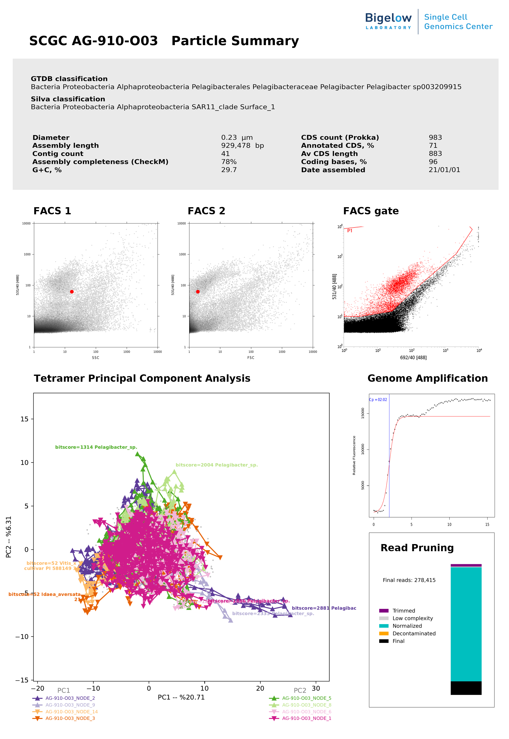
New from SCGC: Particle Summary
{ID}
Visual summary of SAG
Available for 2023 datasets onwards.
(Not GORG tropics, sorry!)

Slide 45
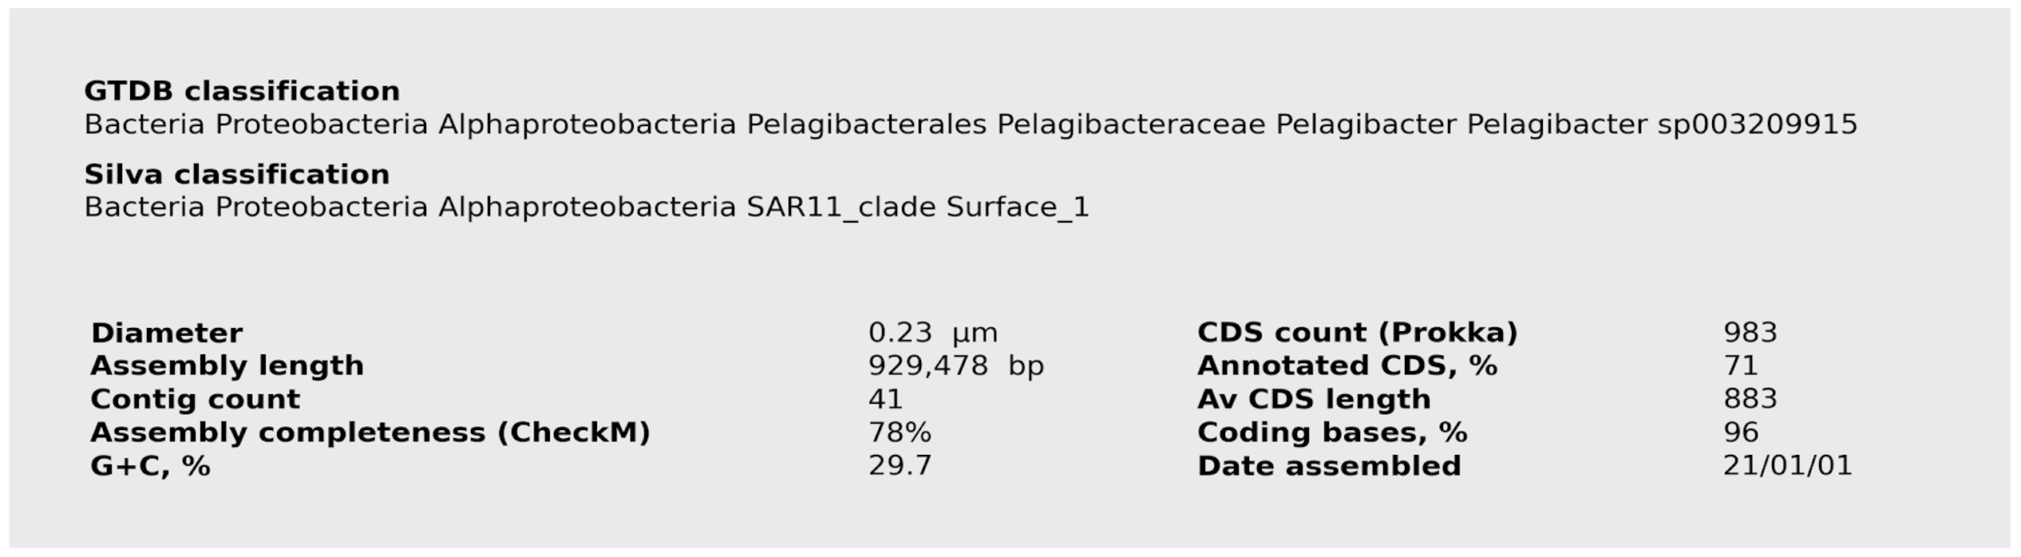
Particle Summary Components
1. Header

Slide 46
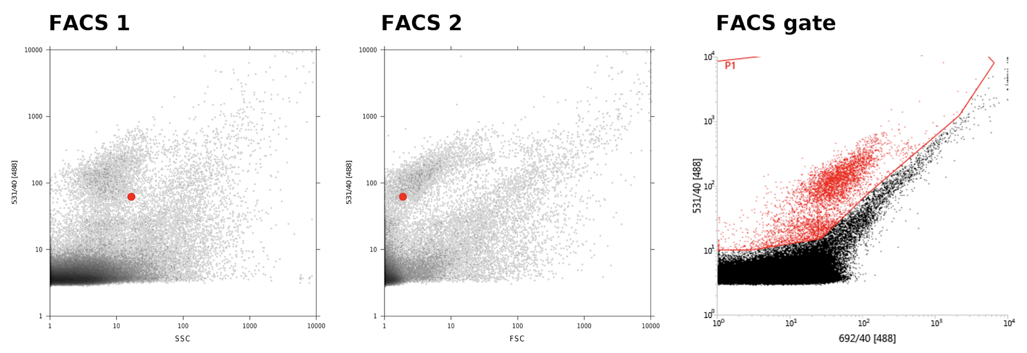
Particle Summary Components
2. FACS info

Slide 47
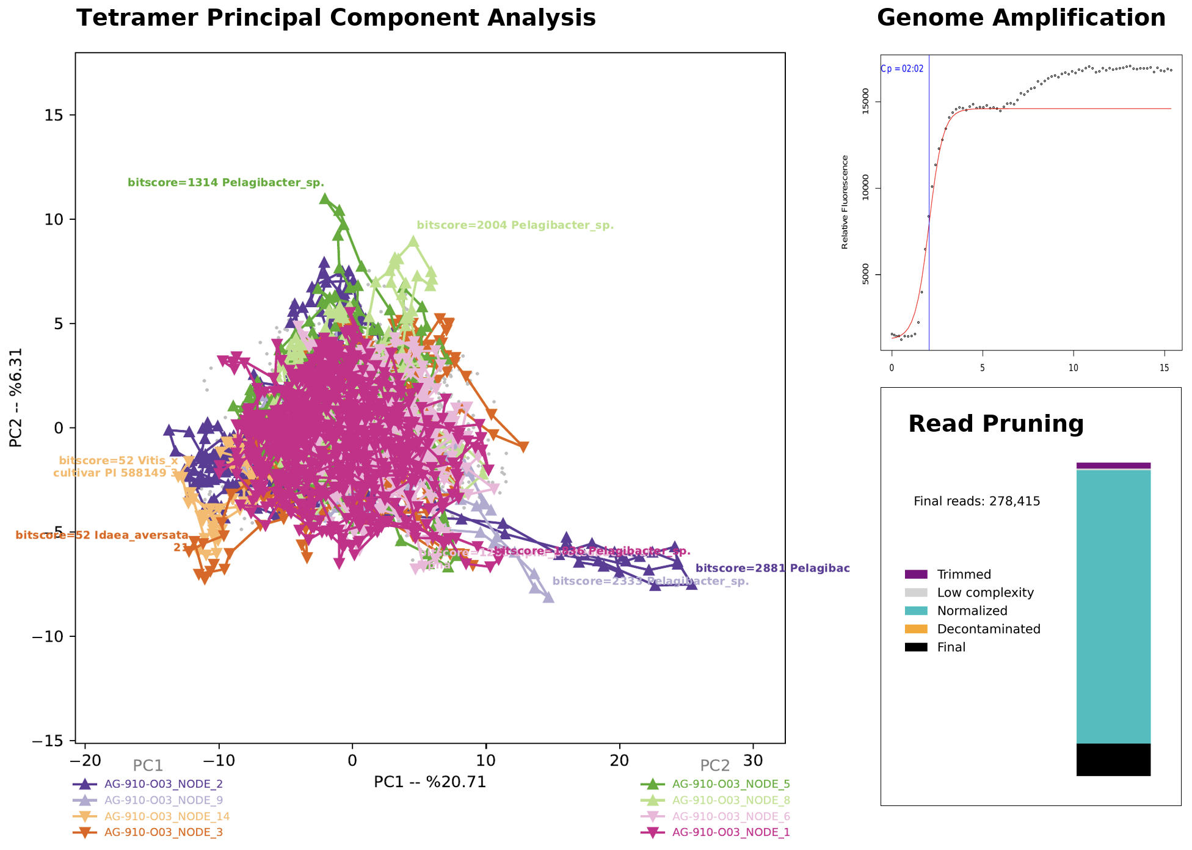
Particle Summary Components
3. Everything
else…

Slide 48
Future Improvements:
Please let us know what tools could be used to improve our pipeline
Thanks!

Slide 49
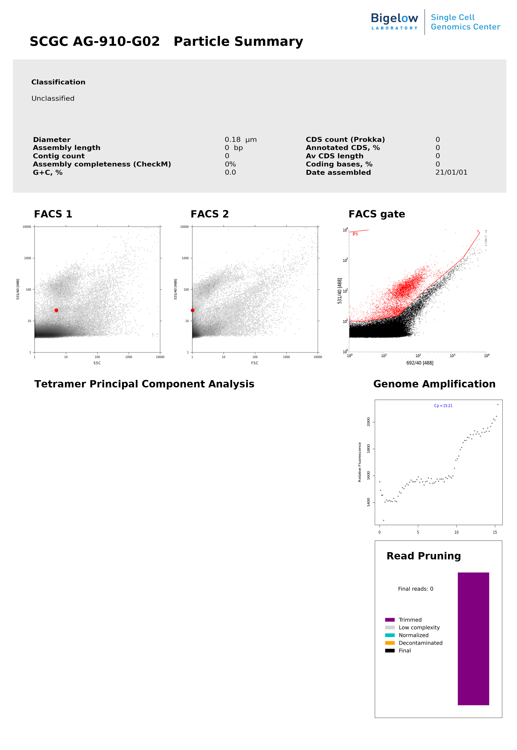
Q1: What went wrong with this sample?

Slide 50
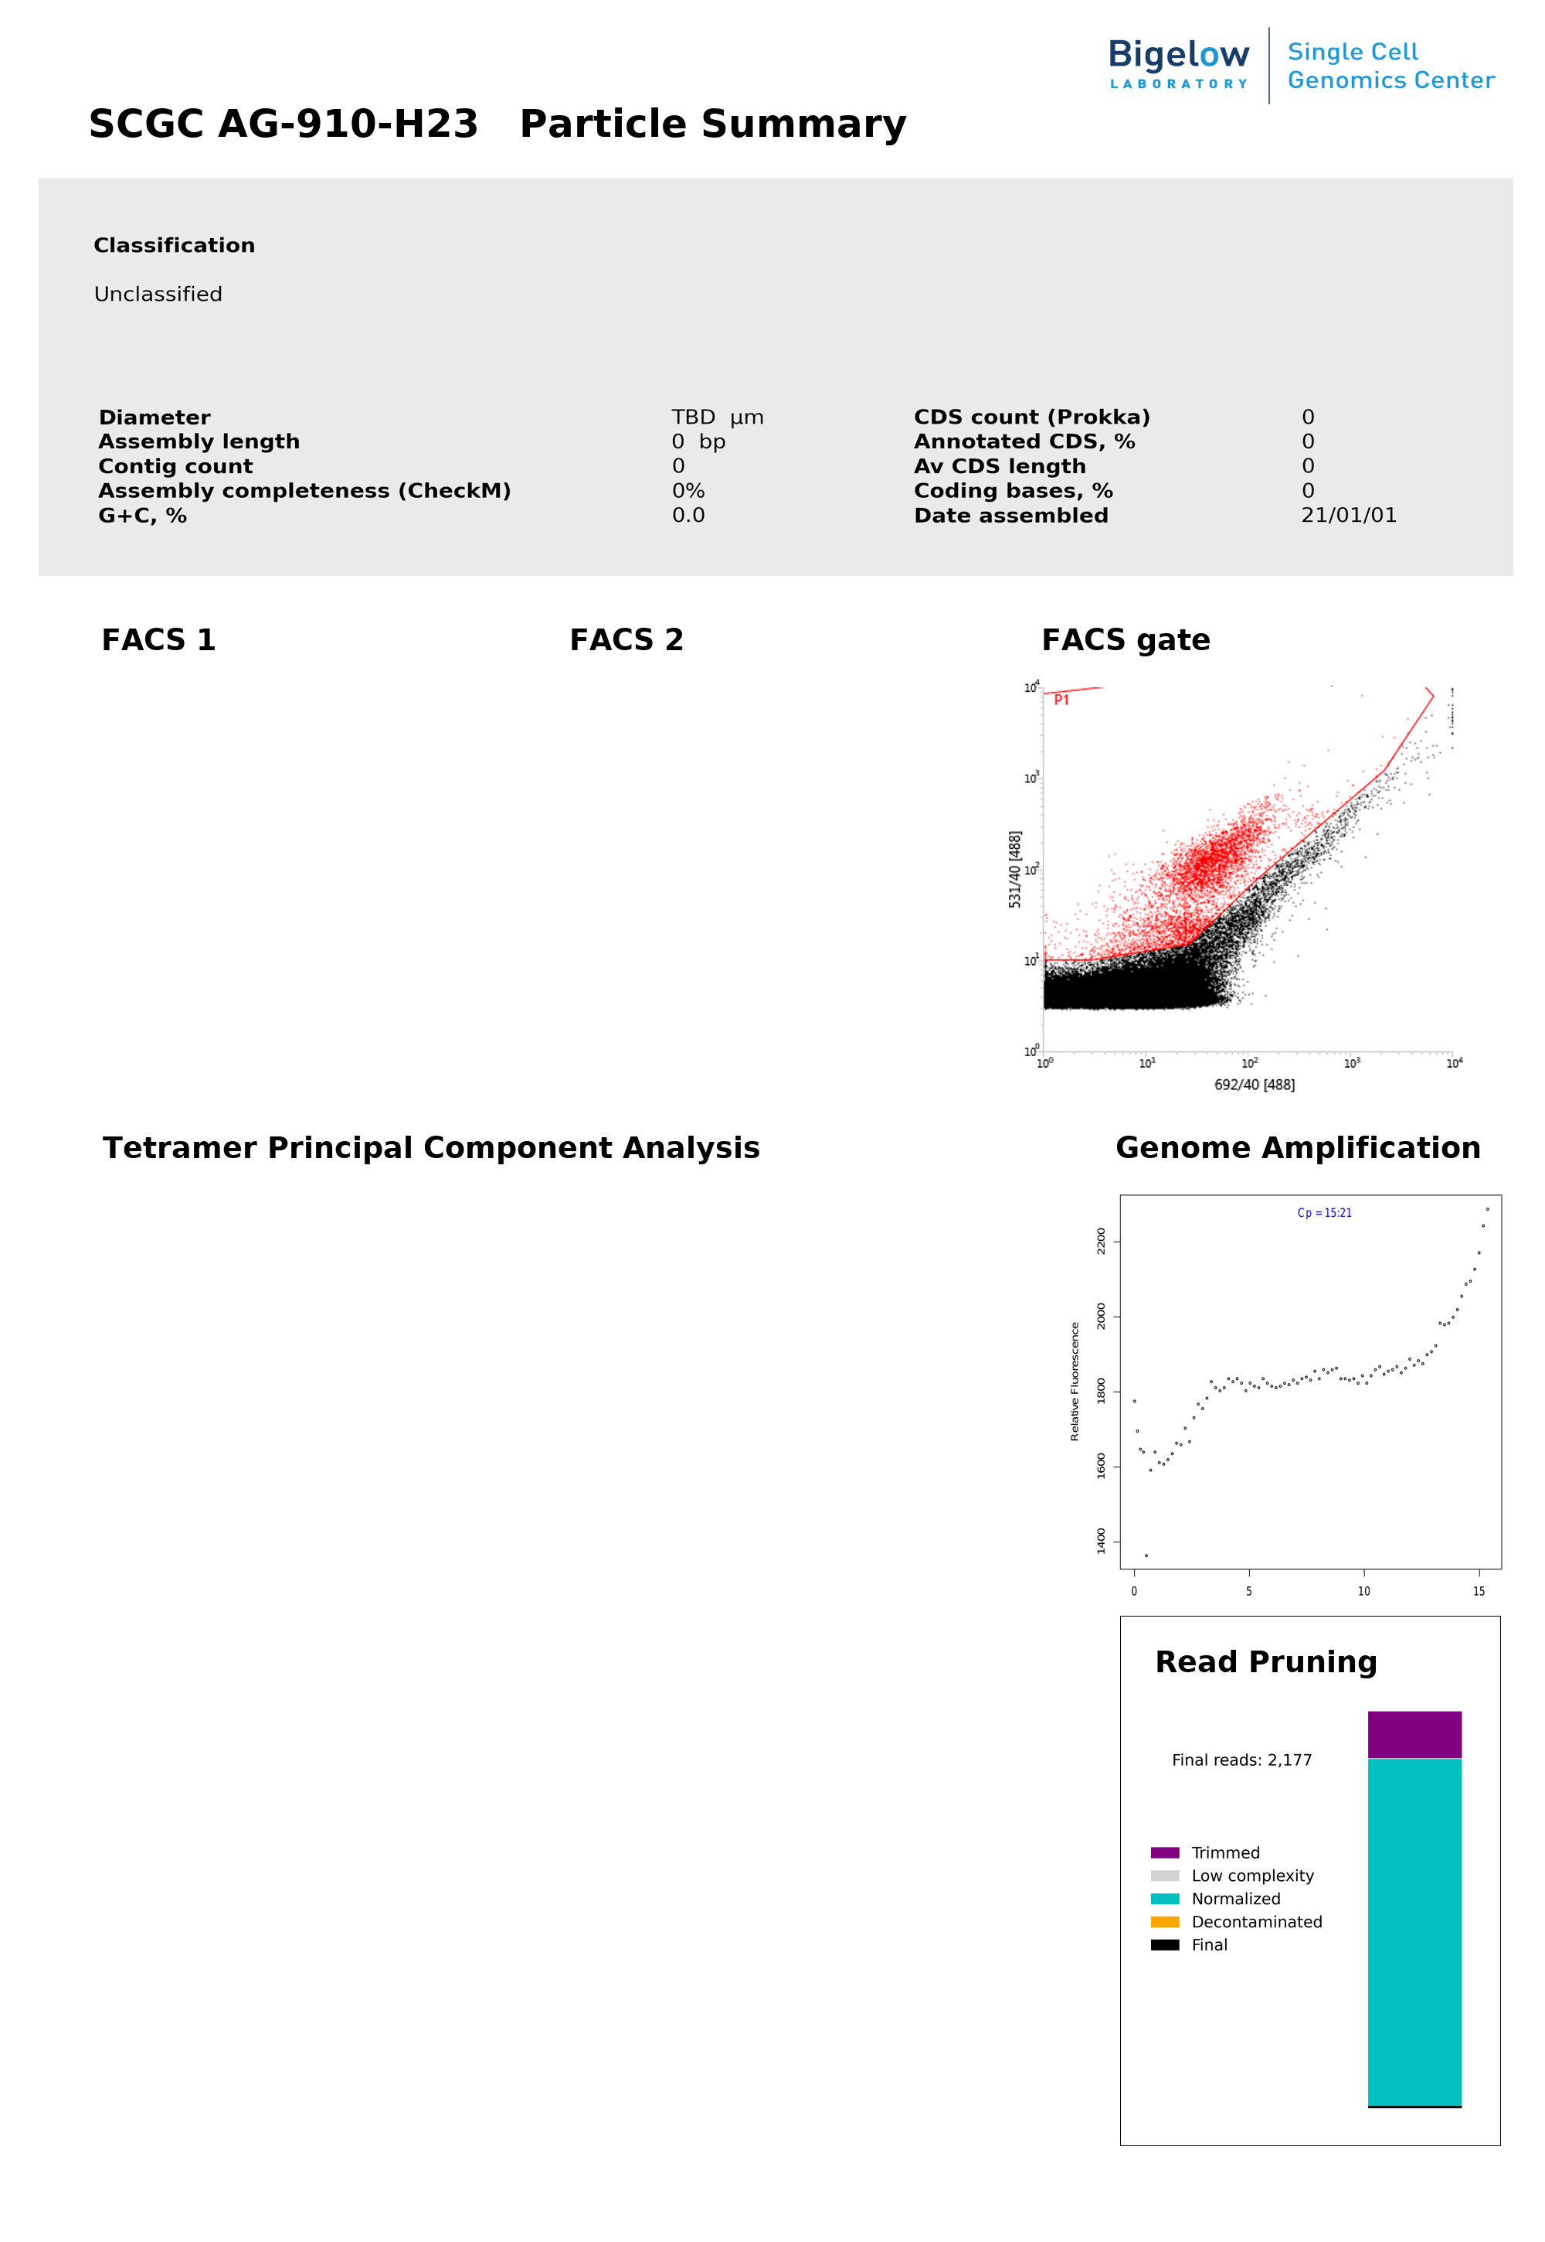
Q2: What went wrong with this sample?

Slide 51
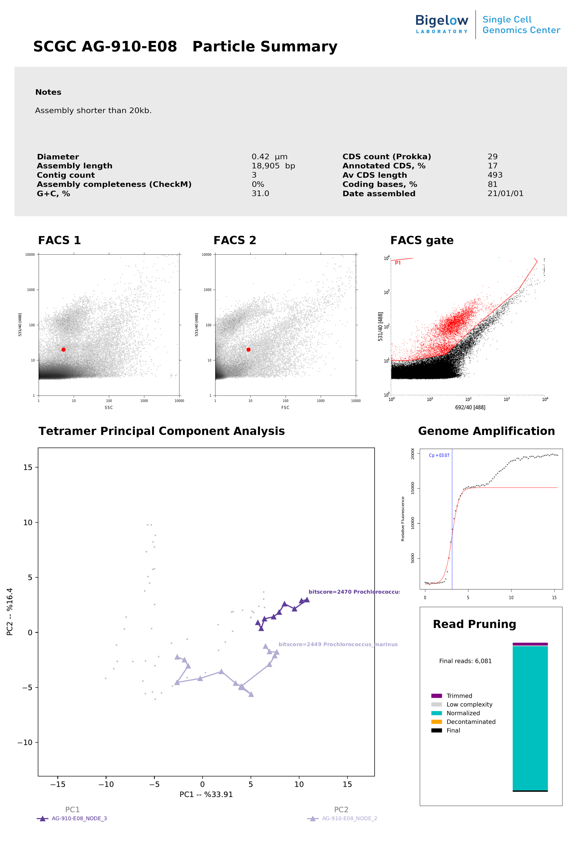
Q3: What went wrong with this sample?

Slide 52
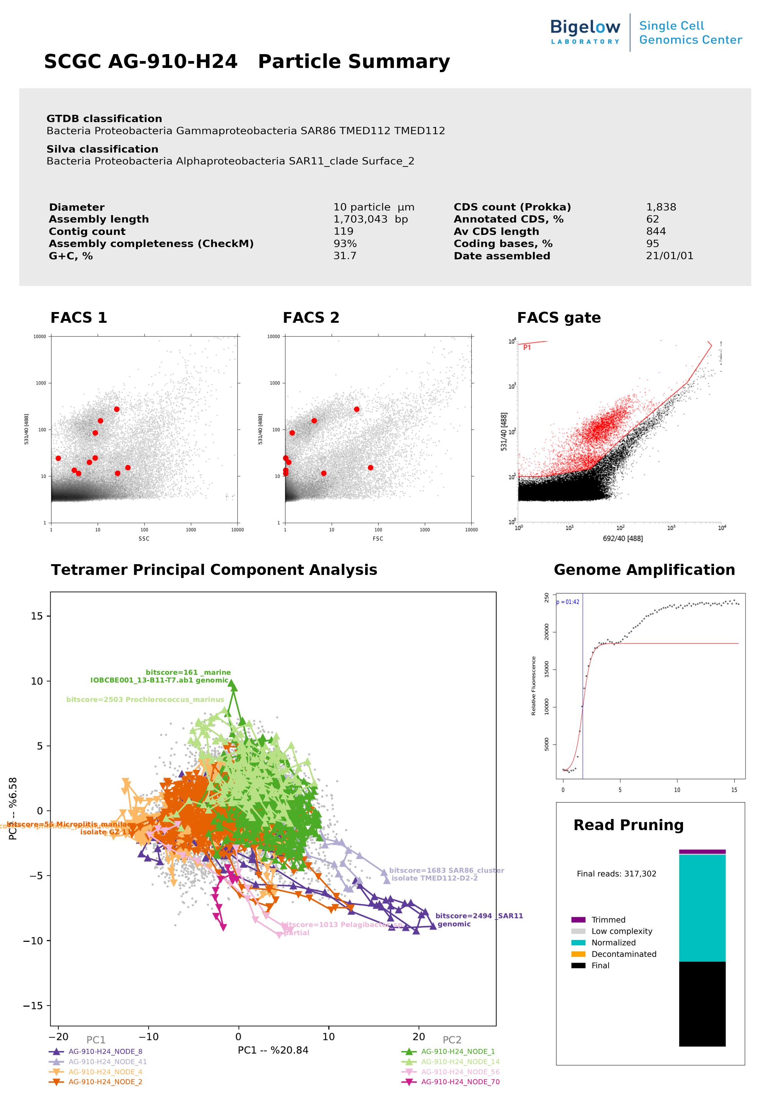
Q4: What went wrong with this sample?

Slide 53
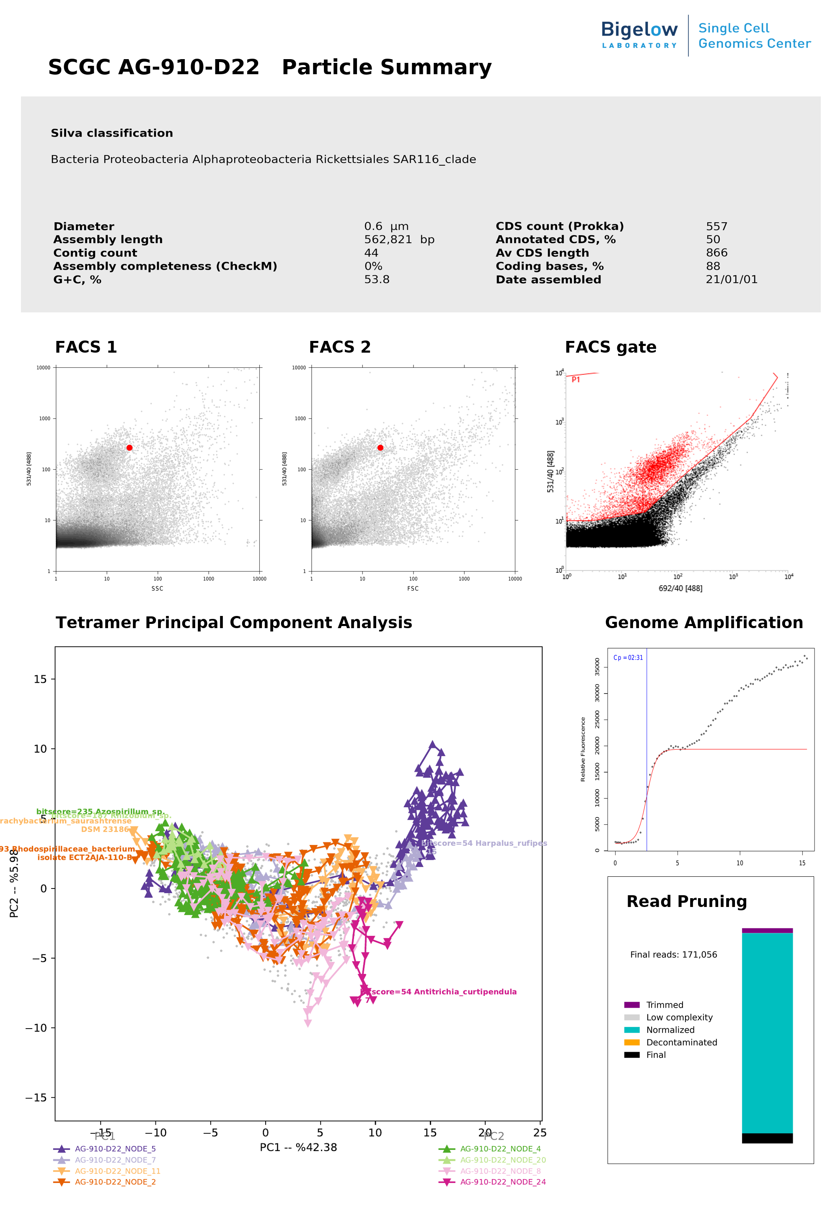
Bonus Q5: What went wrong with this sample?

Slide 54
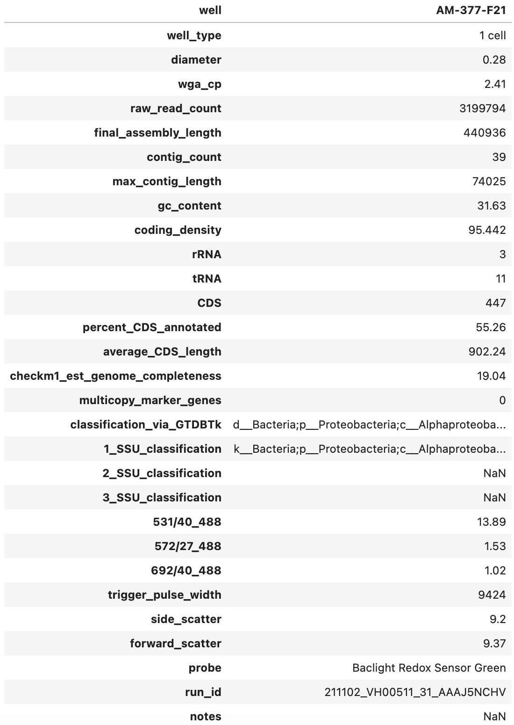
Summary table
{ID}
Aggregates metrics from FACS, QC & annotation
Notes:
You’ll take a look at that sheet this afternoon, during the interactive session.

